Slide 1
Cyber Simulator Showcase CERT Cybersecurity Workforce Development Part 6 of 6: Industrial Control System and Banking Simulators
Dennis Allen 03 JUN 2019

Slide 2
Copyright 2019 Carnegie Mellon University. All Rights Reserved.
This material is based upon work funded and supported by the Department of Defense under Contract No. FA8702-15-D-0002 with Carnegie Mellon University for the operation of the Software Engineering Institute, a federally funded research and development center.
The view, opinions, and/or findings contained in this material are those of the author(s) and should not be construed as an official Government position, policy, or decision, unless designated by other documentation.
NO WARRANTY. THIS CARNEGIE MELLON UNIVERSITY AND SOFTWARE ENGINEERING INSTITUTE MATERIAL IS FURNISHED ON AN "AS-IS" BASIS. CARNEGIE MELLON UNIVERSITY MAKES NO WARRANTIES OF ANY KIND, EITHER EXPRESSED OR IMPLIED, AS TO ANY MATTER INCLUDING, BUT NOT LIMITED TO, WARRANTY OF FITNESS FOR PURPOSE OR MERCHANTABILITY, EXCLUSIVITY, OR RESULTS OBTAINED FROM USE OF THE MATERIAL. CARNEGIE MELLON UNIVERSITY DOES NOT MAKE ANY WARRANTY OF ANY KIND WITH RESPECT TO FREEDOM FROM PATENT, TRADEMARK, OR COPYRIGHT INFRINGEMENT.
[DISTRIBUTION STATEMENT A] This material has been approved for public release and unlimited distribution. Please see Copyright notice for non-US Government use and distribution.
This material may be reproduced in its entirety, without modification, and freely distributed in written or electronic form without requesting formal permission. Permission is required for any other use. Requests for permission should be directed to the Software Engineering Institute at permission@sei.cmu.edu.
Carnegie Mellon® and CERT® are registered in the U.S. Patent and Trademark Office by Carnegie Mellon University.
DM19-0578

Slide 3
SCADASim & FinSim Industrial Control System and Banking Simulators
Dennis Allen 03 JUN 2019

Slide 4
SCADASim – Intro
SCADASim Intro Video

Slide 5
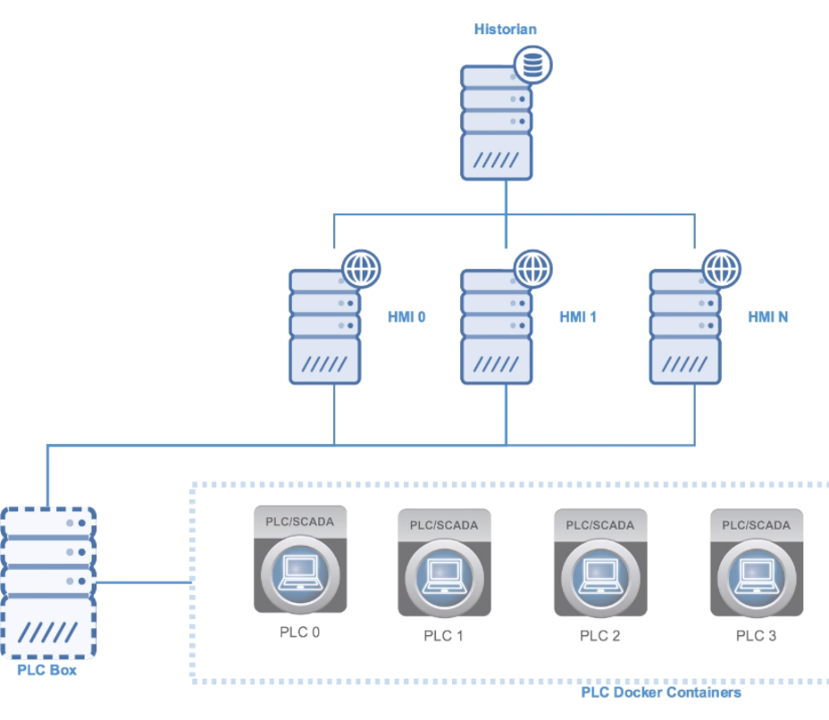
SCADASim – Features
Configurable PLCs
Modbus communications with HMIs
Sample Configurations Available for:
Water treatment plants
Power generation
HVAC
Underlying technology
Docker
Python
Postgres
JSON

Slide 6
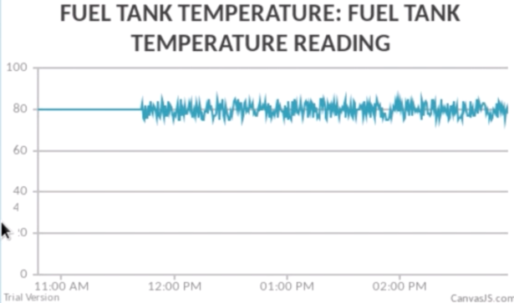
SCADASim – Use Cases
Specific SCADA/ICS Threats
Data exfiltration
Data modification
General Threats
Denial of Service
OS and Web exploits
Industrial Controls System Reference Architectures
Event correlation
Mitigating/Compensating controls implementation
Realistic network traffic generation

Slide 7
Cyber X-Games 2018 – Example
Focused on DoD’s role in protecting critical infrastructure
10 Cyber Protection Teams deployed simultaneously to 10 different sectors of critical infrastructure per PPD-21
Teams were required to work together to defend their sector against hacktivist and nation-state threat actors.
Teams were scored on the effectiveness of defenses, communication, and collaboration

Slide 8
Cyber X-Games 2018 Sectors
Chemical Sector
Communication Sector
Dams Sector
DIB Sector
Energy Sector
Financial Services Sector
Government Facilities Sector
Healthcare Sector
Transportation Sector
Water/Waste Sector

Slide 9
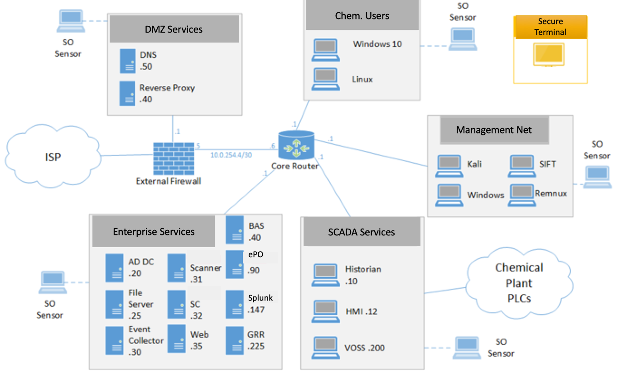
Cyber X-Games 2018 Topology

Slide 10
SCADASim – What’s Next
Improve configuration management
Other SCADA/ICS simulator integration
Additional threat scenarios
https://github.com/cmu-sei/scada-simulator

Slide 11
SCADASim – Lab Walkthrough

Slide 12
FinSim – Intro
FinSim Intro Video

Slide 13
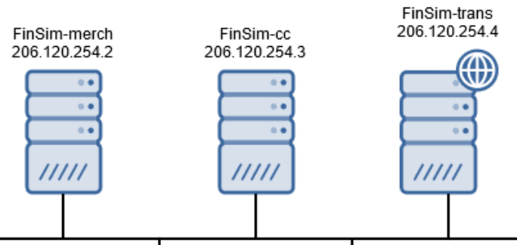
FinSim – Features
Model financial system within a training environment
Banks (accounts and web interface)
Credit Card processors
Merchants
Underlying technology
Python
Angular
Flask
MySQL
JSON Web Tokens (JWT)

Slide 14
FinSim – Use Cases
Specific Financial Threats
Financial Fraud/Theft
General Threats
Poor Architecture (e.g. Signing Key and/or Credential reuse)
Stolen/forged JWT tokens
Denial of Service
OS and Web exploits
Incident response and event reconstruction
API insecurity

Slide 15
FinSim – What’s Next
Replace SSL with SSH tunneled transactions
Dockerize Merchants
Merchant Web Storefront
Bank Website improvements
Integrate ATM Scenarios
https://github.com/cmu-sei/finsim

Slide 16
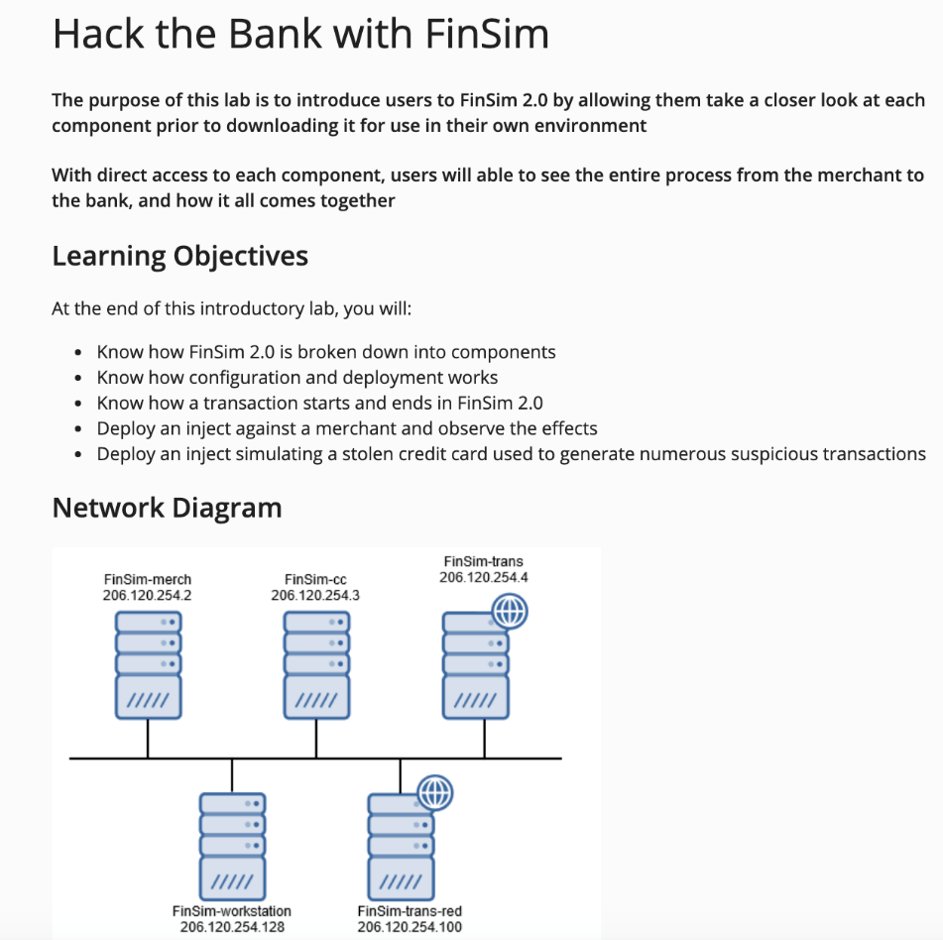
FinSim – Lab Walkthrough

Slide 17
Questions ?

